Slide 1
Name: Wong Yi Tung Benjamin Student admin no: P7460926 AMPL CA 1

Slide 2
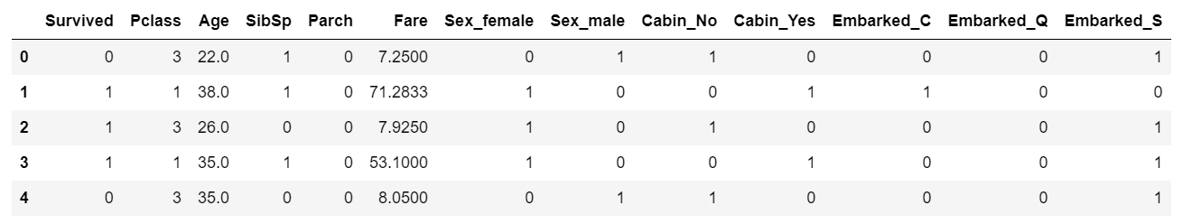
Classification: Titanic dataset
Preprocessing data
All the data has to be in numbers for our models to work and make predictions
Data like name and passenger ID that definitely has no effect on the prediction results are omitted
Data that are blank has to be replaced with either mean or mode (Age used mean as age is distributed normally, Price and Embark used mode as both are skewed)
Data that are not numbers have to be repackaged into numbers using dummies from pandas. Screenshot of part of the data after cleaning shown below

Slide 3
Classification: Titanic dataset
Machine Learning process
We will be training the program to predict whether a titantic passenger survives based on the passenger’s data. (Survived = 1, Died = 0)
The train set was split into validation set and train set as we do not have the data for survived on the test set (80% of the train data was train set)
The data was fitted into 3 models and for each, a confusion matrix was plotted and accuracy score calculated: Logistic regression, KNearestNeighbors, Decision tree
3 models were used as there is no best model or one-size-fits-all model. We will have to find out the model that has the highest accuracy score in order to make the best prediction and use that model for future predictions
The higher the accuracy score for a model, the better the model can predict the fate of the passengers and will be more likely to make more accurate predictions
Parameters used were all default parameters
Screenshots on the next slide

Slide 4
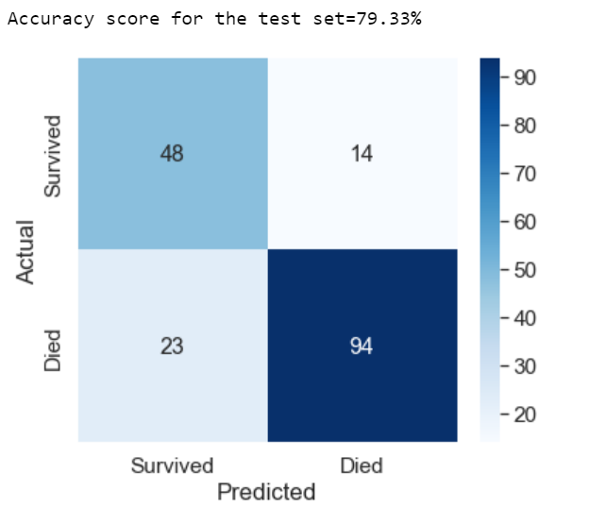
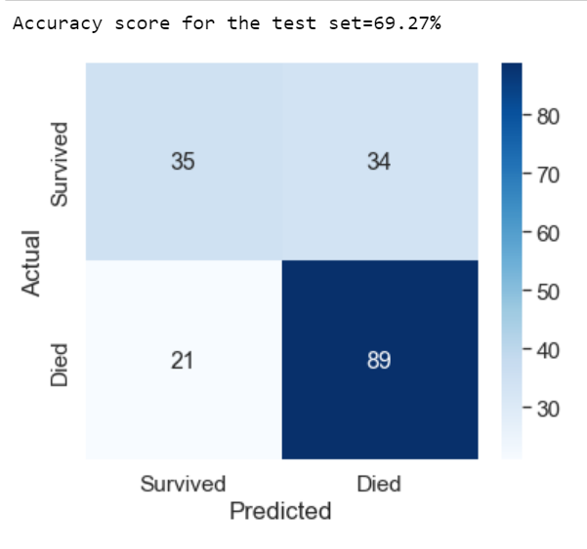
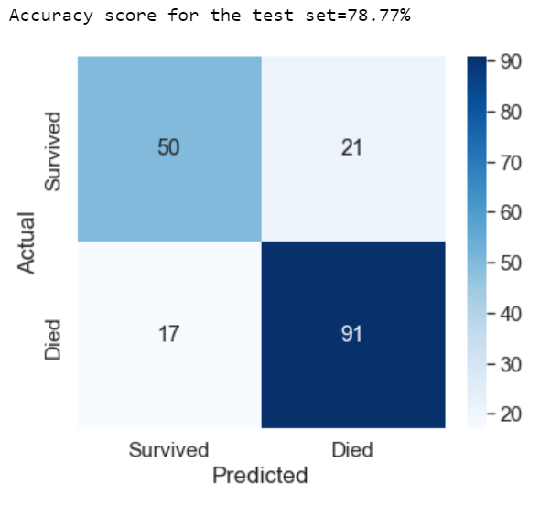
Classification: Titanic dataset
Logistic Regression
KNearestNeighbours
Decision Tree

Slide 5
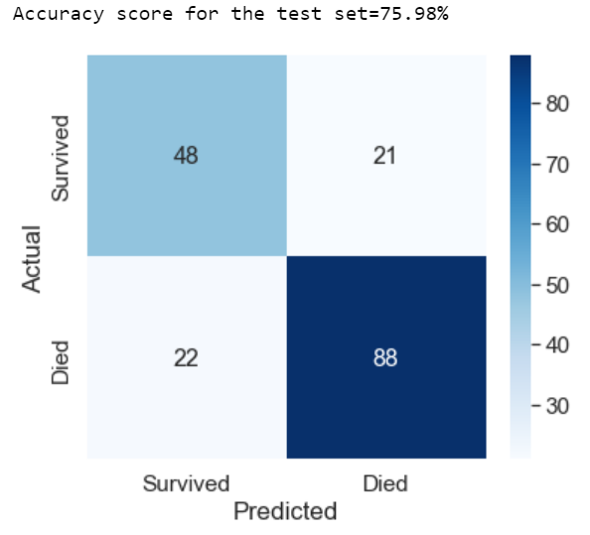
Classification: Titanic dataset
Hyperparameter tuning
RandomisedSearchCV was used for each model to search for the optimum hyperparameters with 5-fold cross validation (cv = 5)
Each of the 3 models were run again with the optimized parameters, confusion matrix and accuracy scores were tabulated
Comparison between default parameters and optimised parameters are as follows (left = default, right = optimised)
Logistic Regression

Slide 6
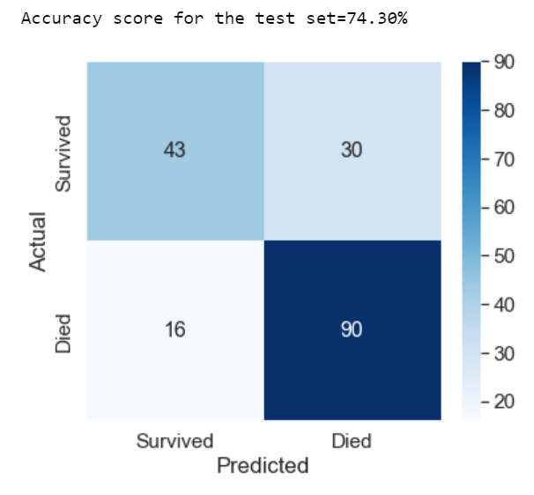
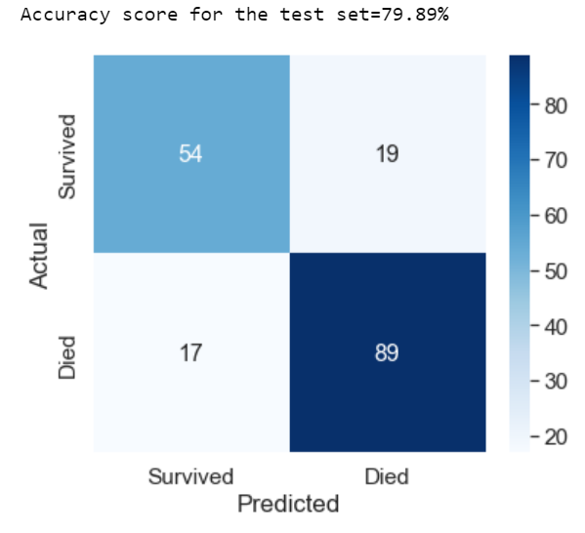
Classification: Titanic dataset
KNearestNeighbors
Decision Tree

Slide 7
Classification: Titanic dataset
Evaluations
DecisionTreeClassifier with optimized parameters was the most suitable model of the 3 models as it has the highest accuracy score
We are using the most suitable model to find out which variable (Male/Female, Passenger Class 1/2/3) is responsible for lowering our accuracy score

Slide 8
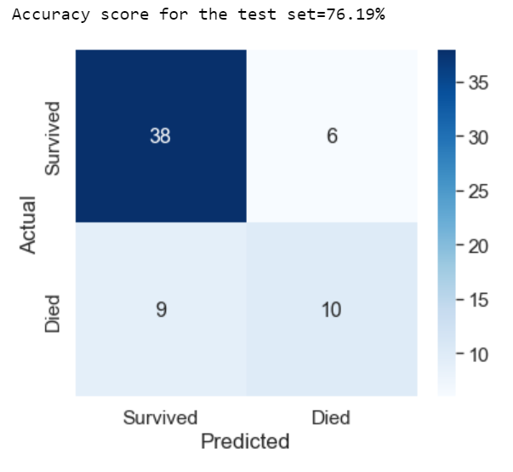
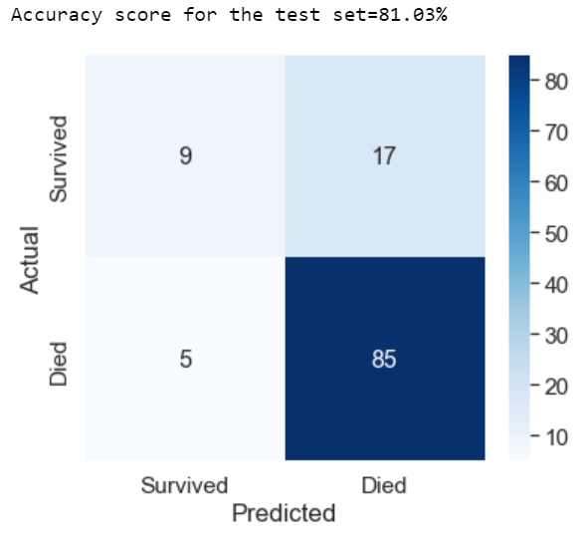
Classification: Titanic dataset
Dtc analysis for female and male respectively

Slide 9
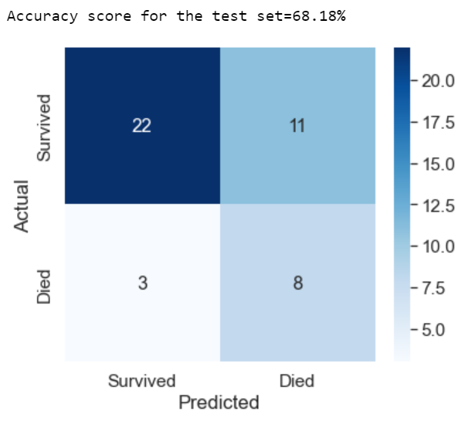
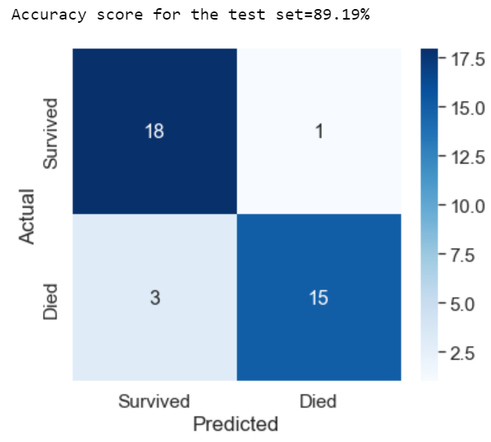
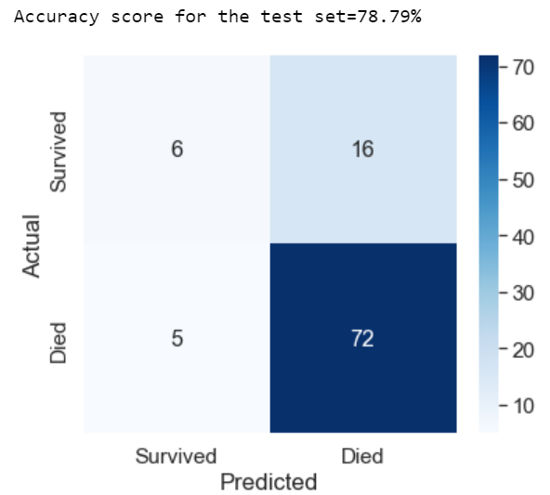
Classification: Titanic dataset
Dtc analysis for Class1, Class2 and Class3 respectively

Slide 10
Classification: Titanic dataset
Conclusions
Logistic Regression was the most suitable model if hyperparameters are not tuned.
Hyperparameter tuning generally increased the accuracy score for our models
After hyperparameter tuning, the best model changed
In general, male and female variables did not affect accuracy score significantly
Class 1 passengers lowered the accuracy score very significantly as they have the lowest accuracy score of all the variables

Slide 11
Regression: KC housing dataset
Preprocessing data
All the data has to be in numbers for our models to work and make predictions
Data like dates, ID and area of parts of each room that definitely has no effect on the prediction results or are part of other data are omitted
There are no missing data in this data set so no handling of missing values

Slide 12
Regression: KC housing dataset
Machine Learning process
We will be training the program to predict the price of a house in King’s County in Seattle
The data set was split into test set and train set (80% of the data was train set)
The data was fitted into 3 models and for each, the R2 score was calculated: Linear Regression, Ridge and Lasso
3 models were used as there is no best model or one-size-fits-all model. We will have to find out the model that has the highest R2 score in order to make the best prediction and use that model for future predictions
The higher the R2 score for a model, the better the fit of the data onto that model
Parameters used were all default parameters
Screenshots on the next slide

Slide 13
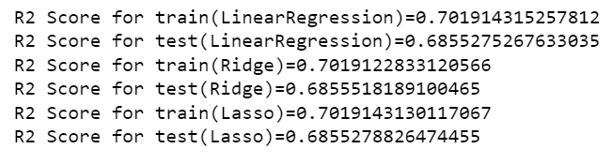
Regression: KC housing dataset

Slide 14
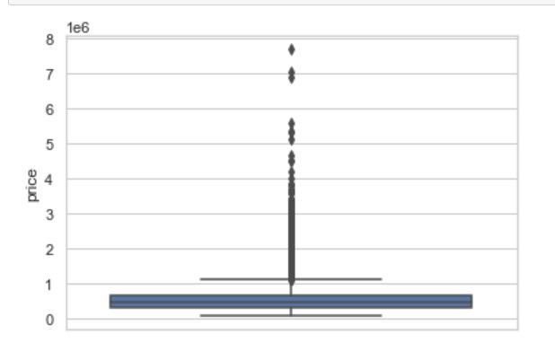
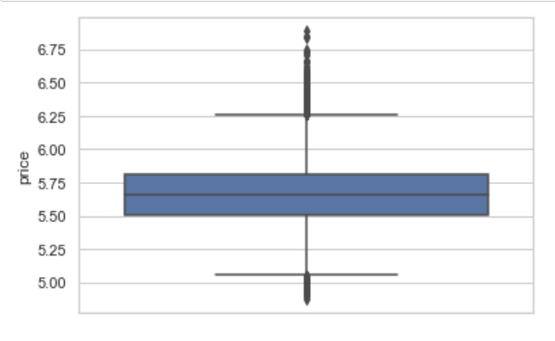
Regression: KC housing dataset
Evaluation
The R2 scores for all 3 models are generally the same
As shown below, the prices are skewed to the right so we decided to log the prices to make it more evenly skewed. The log price is used for analysis later

Slide 15
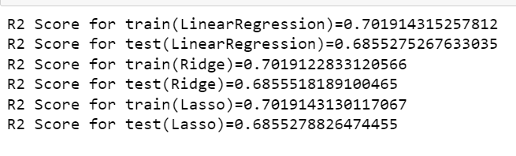
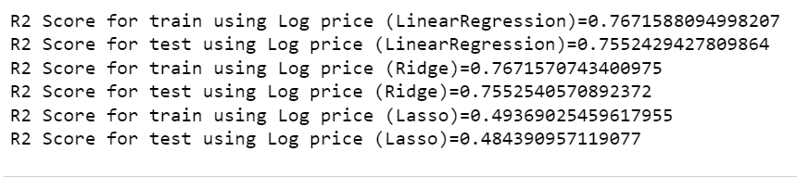
Regression: KC housing dataset
As seen, using evenly skewed data will yield clarity on which is the most suitable model

Slide 16
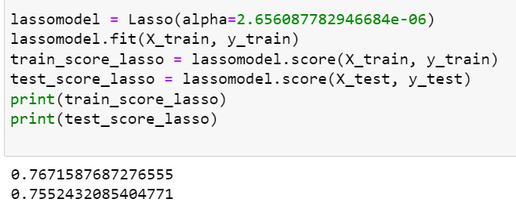
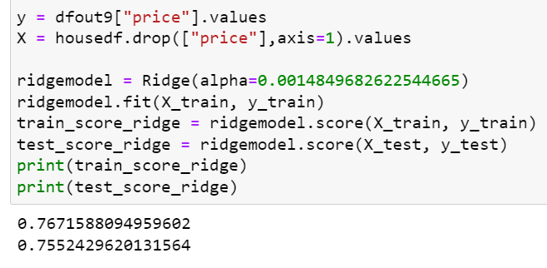
Regression: KC housing dataset
Conclusion
Hyperparameter tuning for Lasso and Ridge was done
Both Lasso and Ridge with the optimum hyperparameters have a R2 score of about 0.767, therefore, both are suitable models for the housing data

